Slide 1
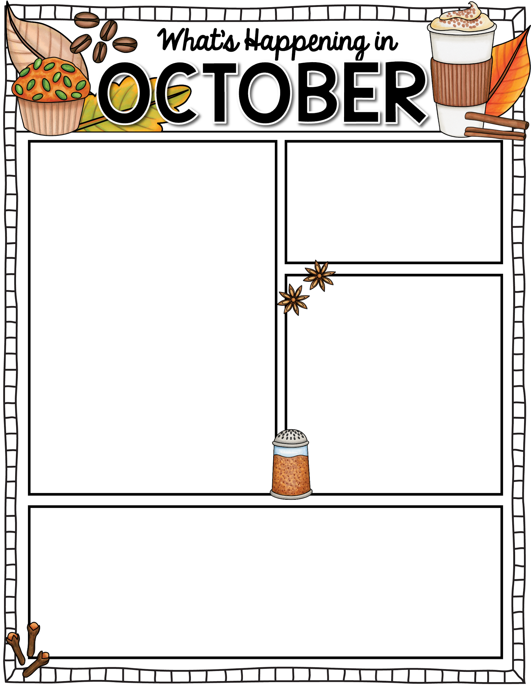


What’s happening in the classroom:
October Bible Memory:
We are all nicely settling into our routines in the classroom! We have begun our literacy program starting with the Itchy’s Alphabet letter introduction. We will focus on a letter each week (not in alphabetical order). We will also be introducing the UFLI program which will prepare our students with the foundational skills that will prepare them for Grade 1. We are talking about basic geometric shapes and recognizing numerals 0-10. As we wrap up our Bible Lessons on Creation, we will begin learning about Noah’s Ark. We continue to look at seasonal changes in our environment.
He makes me lie down in green pastures, He leads me beside quiet waters. Psalm 23:2
Dates to Remember:
October 3: P.D. Day
October 13: Thanksgiving
October 21: Chip Day
Animal Dress Up Day
October 23: Muffins with Mom (See invite and RSVP)
October 31: Nature Detective In-class field trip.
Things to Remember:
If your child does not ride the bus, please plan to arrive at school in time for dismissal at 3:19pm (2:19pm on Wednesdays).
Our parent helper schedule will be shared next week. Helpers Days will commence in October.
Our Library book exchange will happen every Tuesday. Please return books in the library bag provided.

