Slide 1
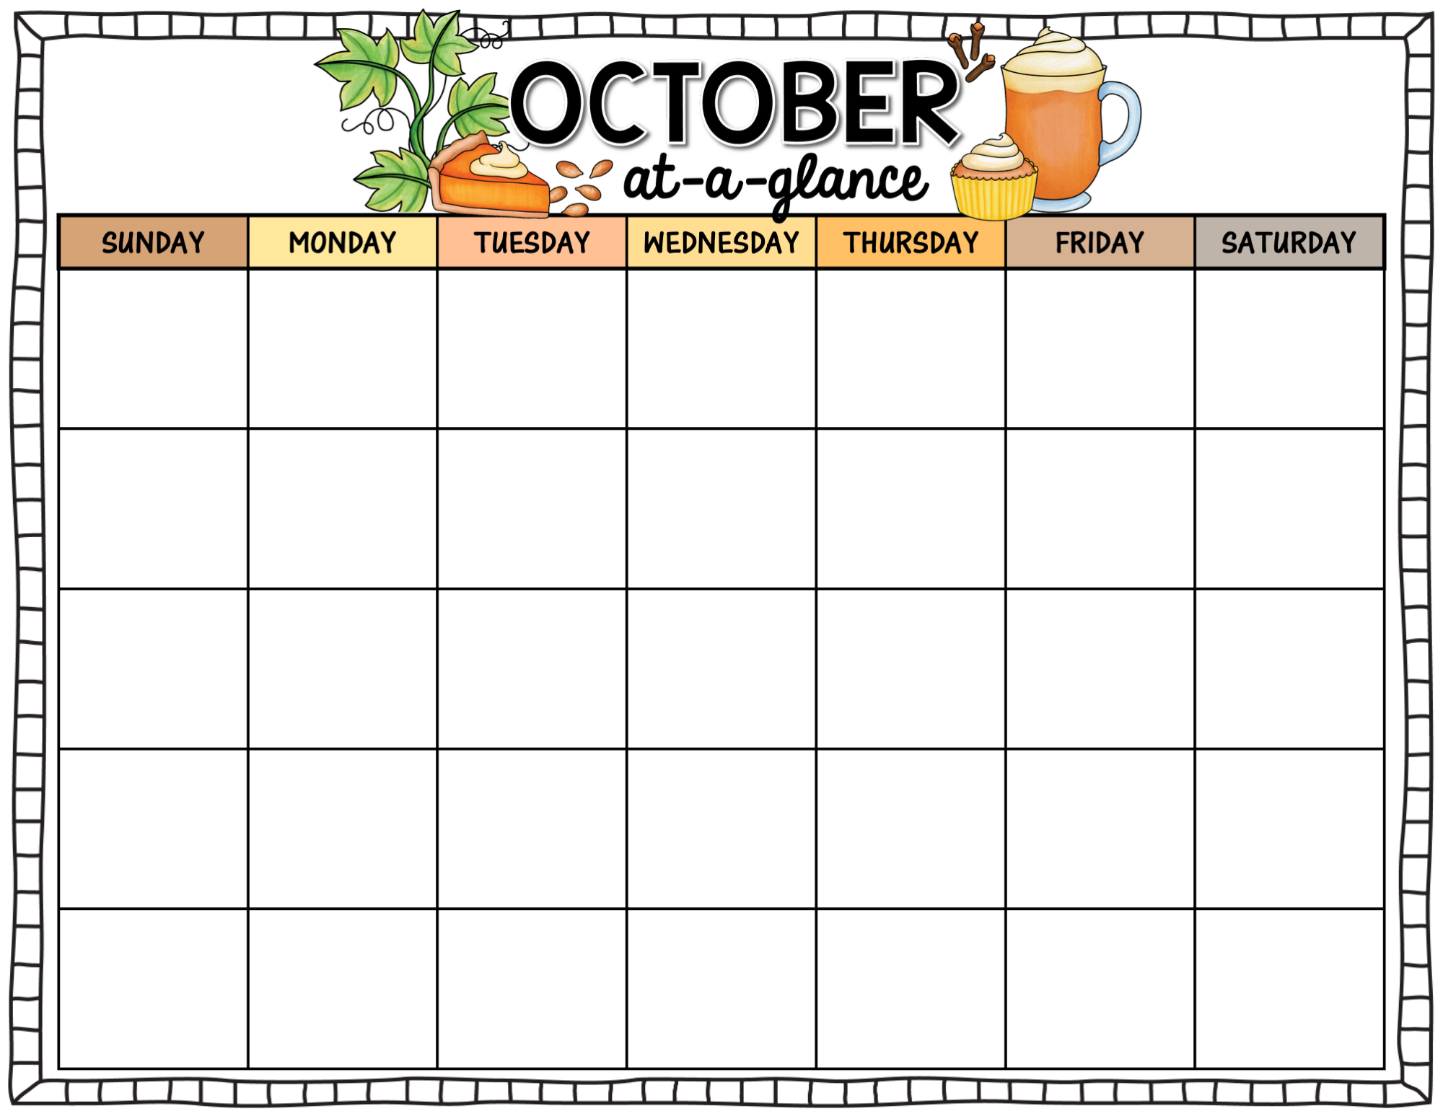




KB Class
2025
 |  |  | 1 | 2 | 3 | 4
5 | 6 | 7 Library | 8 | 9 | 10 | 11
12 | 13 | 14 Library | 15 | 16 | 17 | 18
19 | 20 | 21 Chip Day for KB Picture Retakes Library | 22 | 23 Muffins with Moms | 24 | 25
26 | 27 | 28 Library | 29 Early Dismissal 2:19pm | 30 | 31
P.D. Day
No School for Students
Early Dismissal 2:19pm
Thanksgiving Chapel
Early Dismissal 2:19pm
Thanksgiving
Early Dismissal 2:19pm
Nature Detective In-Class Field Trip

